Slide 1





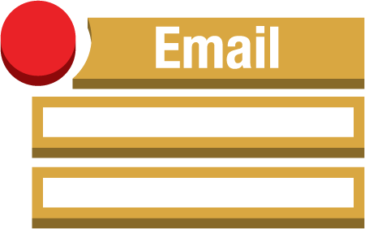



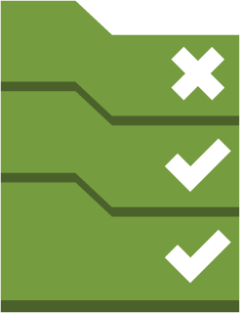
AWS-Region
S3
Cloudtrail
Delivered to CloudWatch Logs
Alarms
Amazon CloudWatch
Email Notification
SNS
Event Rules
Custom Lambda functions
Custom Config rules
Lambda functions
Config Rules
Config

